Slide 1


caArray User Community Meeting
caArray User Community Meeting
2.2.0 Feature Overview and Review of MAGE-TAB Update and Export Specification
Upcoming Releases
Call in: 877-416-5524
Participant Passcode: 2627056
Centra: http://ncicb.centra.com
Meeting ID: ICR_meeting
November 5, 2008
Call in: 877-416-5524
Participant Passcode: 2627056
Centra: http://ncicb.centra.com
Meeting ID: ICR_meeting
May 6, 2009

Slide 2
Agenda
Patch Release
2.2.1 Update
2.3.0 Update
Demo of ownership change
Q&A

Slide 3
Patch Release
Installer issue
  caArray installers and upgraders use ant tasks to configure XML files and validated them against respective DTDs hosted at JBOSS web site. However, some DTDs are no longer available at JBOSS website which caused the installers and upgraders to fail. This issue was addressed in caArray installer 2.2.0 Patch1.

Slide 4
2.2.1 Update
Release of caArray 2.2.1 third week of May
Status:
  Completed testing on QA tier
  Completed installer testing
  Deployment to Stage tier this week

Slide 5
2.3.0 Update
Grid security has been deferred to a future release
Main focus will still be the new API
  Applications are encouraged to migrate to the new APIs as soon as possible to take advantage of a richer set of methods, improved performance and a backwards-compatibility framework.
  Applications with no authentication requirement can use the Java API or the Grid API.
  Applications needing authenticated access must use the Java API.
  We will add authentication support to the Grid API in a future release.

Slide 6
Demo: Ownership change
Change owner of experiments or groups
  System administrator can pick
    experiments owned by a particular user; and/or
    collaboration groups owned by a particular user
  System administrator can set the owner to a new user.

Slide 7
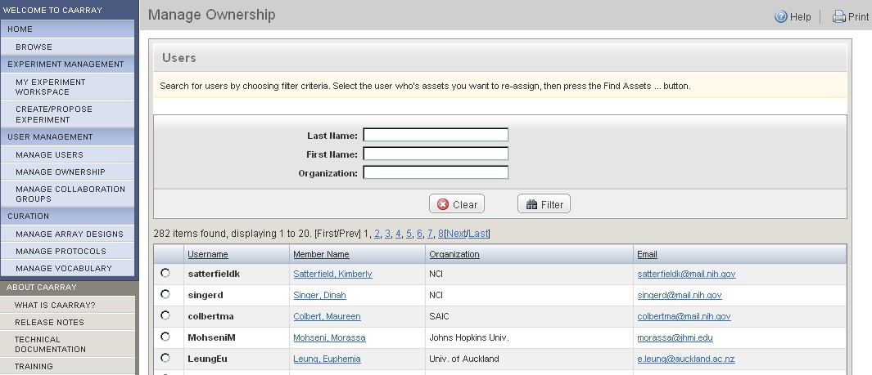
Demo: Ownership change

Slide 8
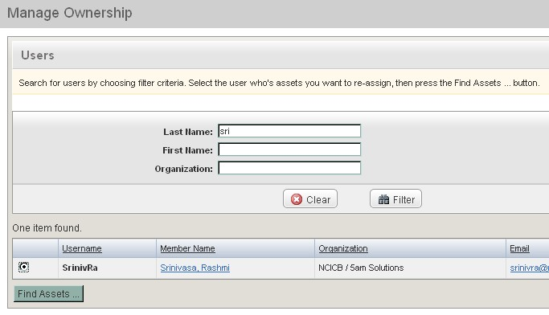
Demo: Ownership change

Slide 9
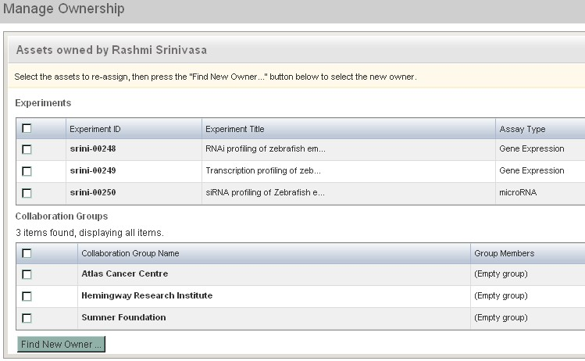
Demo: Ownership change

Slide 10
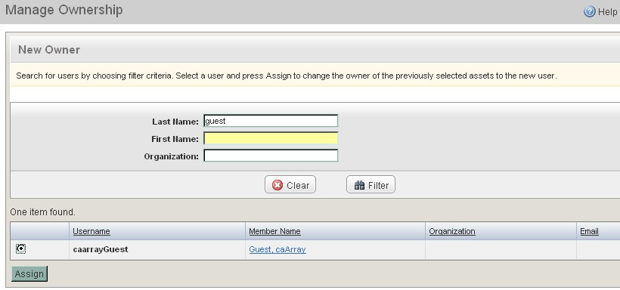
Demo: Ownership change

Slide 11
Avenues for Feedback
Molecular Analysis Tools Knowledge Center Forum
GForge Community Change Request tracker:
  http://gforge.nci.nih.gov/tracker/?atid=1339&group_id=305&func=browse
This meeting
Next Meeting:
Wednesday, June 3, 2:00 PM ET

